Slide 1
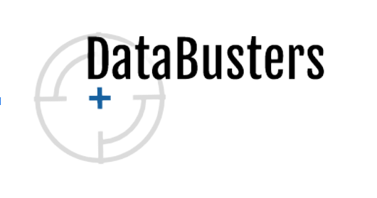

QTM2020 Final Presentation
Prof. Pachamanova
Altug Kalfazade, Efe Bora, Linh Ha, & Ziya Aydin
Notes:
Efe

Slide 2

Bankruptcy in Taiwan
Taiwan
Notes:
Efe: Bankruptcy has a negative impact both on the enterprise itself and the global economy. Business practitioners, investors, governments, and academic researchers have long studied ways to identify the potential risk of business failure in order to reduce the economic loss caused by bankruptcy

Slide 3
Roadmap
Data Prep
Logistics Regression
Decision Trees
1
3
5
2
4
6
Clustering
kNN
Business Recommendations
Notes:
Efe

Slide 4
Data Prep
1
Let’s begin
Notes:
Efe

Slide 5
6,819
95
10
Companies in our data set
Financial ratios
Years, from 1999 to 2009
Notes:
Altug - We had 6819 companies in our dataset the names of which we do not due to confidentiality standards, most of them were manufacturing companies as our research showed that majority of companies in Taiwan is manufacturing companies. In the finance industry there are more than 300 financial ratios but our data set has 95 different ratios.

Slide 6
Goal
Target
Predictors
Explaining the relationship between financial ratios and the risk of companies going bankrupt
Bankruptcy → 1 or 0 binary variable (Yes or No)
95 financial ratios, all numerical and already scaled
Notes:
Altug - predictors were already scaled range from 0 to 1

Slide 7
Our Data
Bankruptcy | Number of Companies | Percentage of Companies
0 (No) | 6,599 | 97%
1 (Yes) | 220 | 3%
Grand Total | 6,819 | 100%
Notes:
Altug - our data set mostly constitutes of 0s which means no bankruptcy. We also had a limitation because of the

Slide 8
Finding the Significant Predictors
95 to 85 Predictors
By accounting analysis
85 to 25 Predictors
Using Stepwise, P-Value and AIC
25 to 7 Predictors
7 Common variables in Stepwise, Lowest P-Value and AIC
Notes:
First of all we wanted to see which predictors are significant. So we had a unique approach to deal with this. Firstly, we had a preliminary accounting analysis which help us to decrease the predictors from 95 to 85. The reason that we eliminated 10 predictor is to make our model to be applicable to private companies as well. Because these 10 ratios were only applicable to public companies.

Slide 9
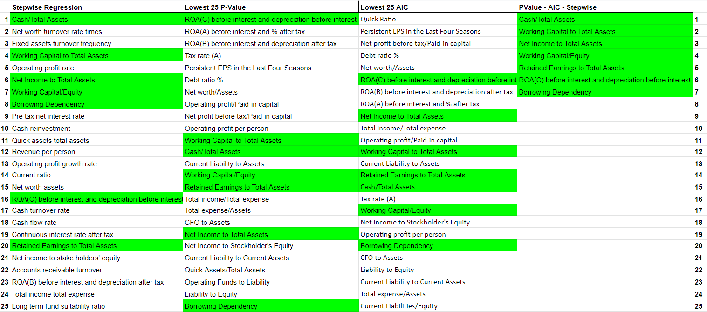
Finding the Significant Predictors
Notes:
After going down to 85 predictors, we ran a one variable logistic regression with each 85 predictors and ranked them based on their P-value and AIC.
Then we ran a stepwise regression. The stepwise regression gave us 25 significant variables.
Lastly we looked at the 25 predictors with the lowest p-values, lowest AICs and predictors that we obtained from the stepwise regression. At the end we came up with 7 final predictors in common.

Slide 10
The 7 Significant Predictors
Cash/Total Assets
Working Capital to Total Assets
Net Income to Total Assets
Working Capital/Equity
Retained Earnings to Total Assets
ROA(C) before interest and depreciation before interest
Borrowing Dependency

Slide 11
Clustering
2
A bunch of things
Notes:
Ziya

Slide 12
Clustering
Low Risk
Medium Risk
High Risk
16 % of the companies
Highest average of 6 financial ratios
Lowest Borrowing Dependency
81 % of the companies
Medium level financial ratios
3 % of the companies
Lowest average of 6 financial ratios
Highest Borrowing Dependency
Notes:
Ziya

Slide 13
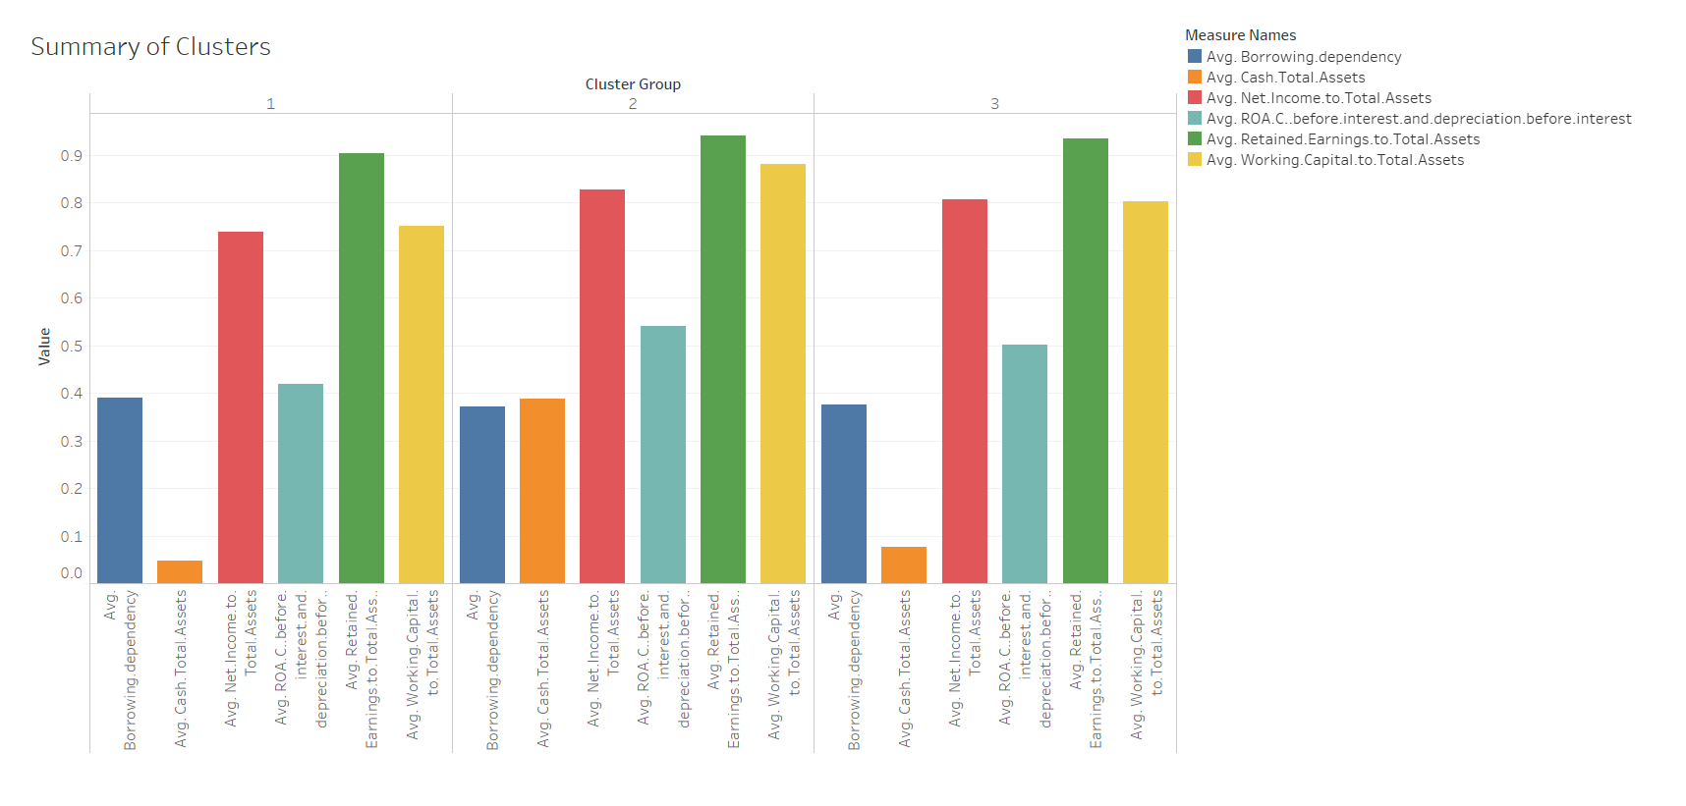
Visualization
Notes:
Ziya

Slide 14
Logistics Regression
3
010110110001001100
Notes:
Linh

Slide 15
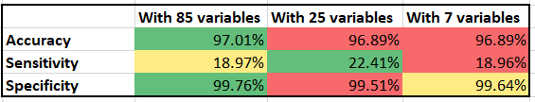
Logistics Regression
Notes:
Linh

Slide 16
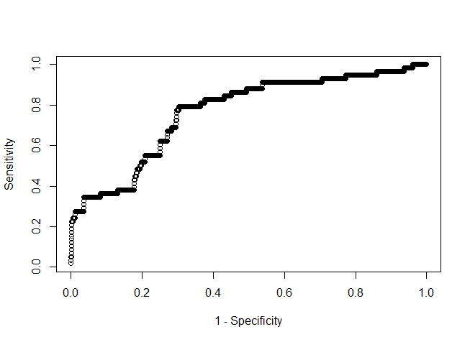
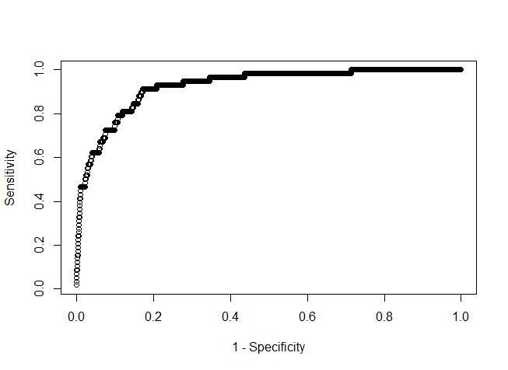
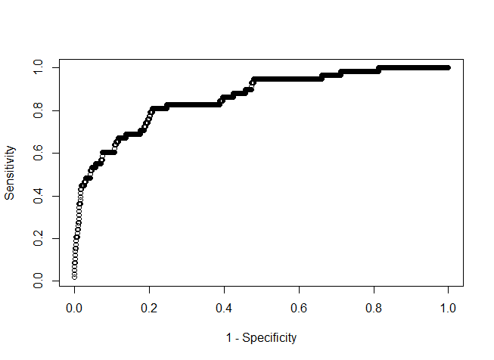
Logistics Regression
85 variables
25 variables
7 variables
AUC = 0.5936
AUC = 0.9265
AUC = 0.8598
Notes:
Linh

Slide 17
Optimal Model:
7 variables
Notes:
Linh

Slide 18
kNN
4
Knock knock!?
Notes:
Altug

Slide 19
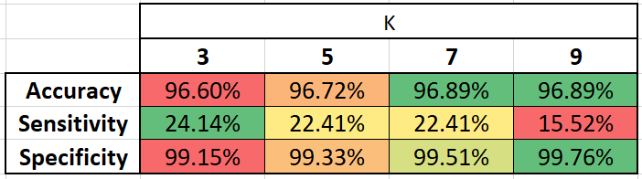
kNN Model
Best K = 7
Notes:
Altug

Slide 20
Decision Trees
5
How far did the apple fall from the tree?
Notes:
Efe

Slide 21
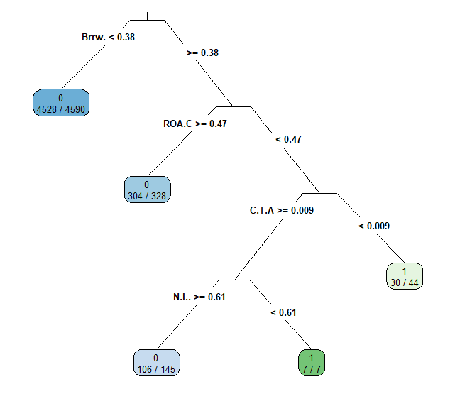
Classification Tree (Imbalanced)
Notes:
Efe

Slide 22
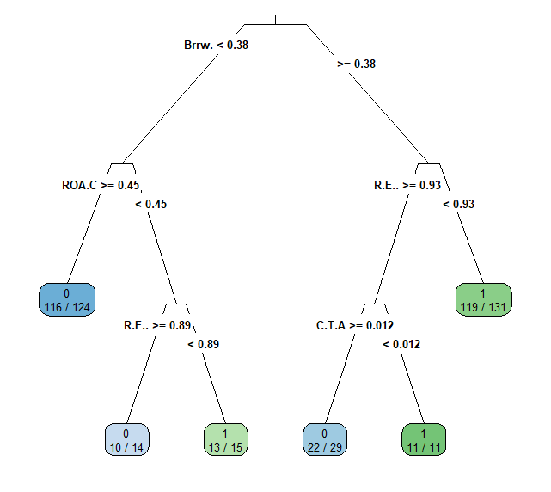
Classification Tree (Downsampled)
Notes:
Efe

Slide 23
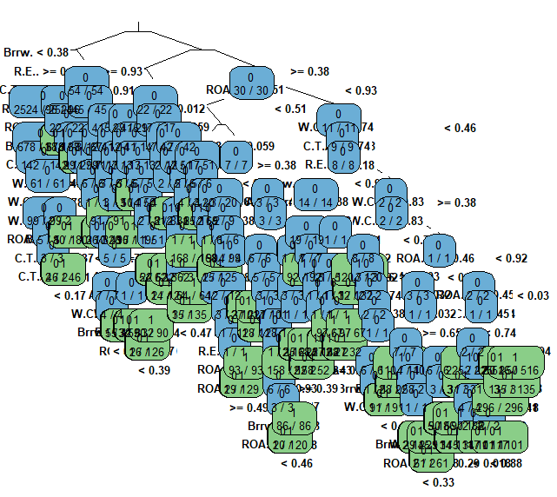
Classification Tree (Upsampled)
:(
Yes, this is pruned.
Notes:
Efe

Slide 24
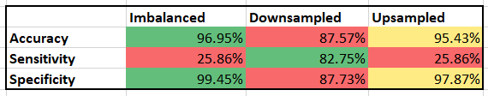
Confusion Matrix
Notes:
Efe

Slide 25
Business Recommendations
6
So… what now?

Slide 26

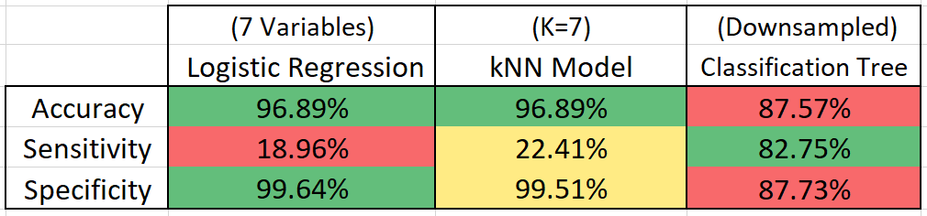
Best Model
Notes:
Linh

Slide 27
Data Findings
Increasing the number of variables doesn't mean that the model is getting better
Accuracy itself is not a very reliable measure
Balancing is key for Decision Trees
Notes:
Linh False negatives hurt us the most

Slide 28
Business Recommendations
These 7 financial ratios are the most significant ones to predict the bankruptcy
Cash/Total Assets
Working Capital to Total Assets
Net Income to Total Assets
Working Capital/Equity
Retained Earnings to Total Assets
ROA(C) before interest and depreciation before interest
Borrowing Dependency
Borrowing dependency is the most important ratio.
Avoid “High Risk” companies!
Notes:
Ziya not applicable to other companies

Slide 29
We, Data Busters, are proud to have busted this case. We shall bust many more cases in the future.
Notes:
Ziya

Slide 30




THANKS!
Any questions?
You can find more of our work through our other ventures:
Notes:
Ziya

